Slide 1

McGraw-Hill Technology Education
Copyright © 2006 by The McGraw-Hill Companies, Inc. All rights reserved.

Slide 2
Chapter 7A
Operating System Basics

Slide 3
Functions of Operating Systems
Provide a user interface
Run programs
Manage hardware devices
Organized file storage
7A-<number>
Notes:
Teaching Tip
File and folder storage is covered in chapter 6.

Slide 4
Types of Operating Systems
Real-time operating system
  Very fast small OS
  Built into a device
  Respond quickly to user input
  MP3 players, Medical devices

Slide 5
Types of Operating Systems
Single user/Single tasking OS
  One user works on the system
  Performs one task at a time
  MS-DOS and Palm OS
  Take up little space on disk
  Run on inexpensive computers

Slide 6
Types of Operating Systems
Single user/Multitasking OS
  User performs many tasks at once
  Most common form of OS
  Windows XP and OS X
  Require expensive computers
  Tend to be complex
Notes:
Teaching tip
It is true that multi-tasking operating systems are complex. However both XP and OS X make the multitasking process painless for the user.

Slide 7
Types of Operating Systems
Multi user/Multitasking OS
  Many users connect to one computer
  Each user has a unique session
  UNIX, Linux, and VMS
  Maintenance can be easy
  Requires a powerful computer
Notes:
Teaching tip
Multi-user Multitasking OS's are found on supercomputers, mainframes and minicomputers. Through Linux, a PC can also support user sessions and terminal connections.

Slide 8
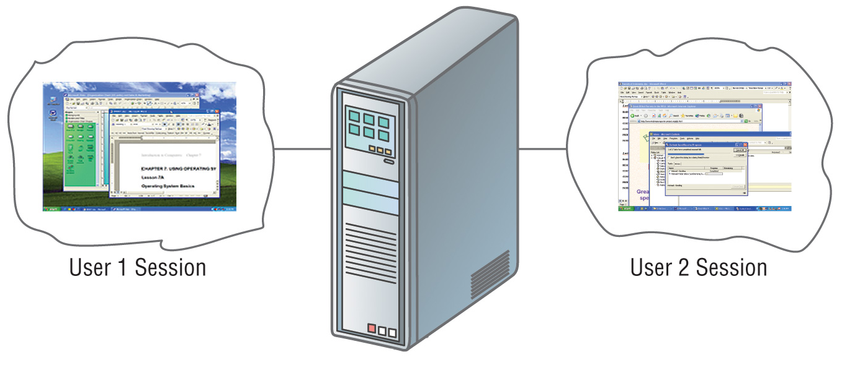
Multi user/Multi tasking OS

Slide 9
Providing a User Interface
User interface
  How a user interacts with a computer
  Require different skill sets

Slide 10
Providing a User Interface
Graphical user interface (GUI)
  Most common interface
    Windows, OS X, Gnome, KDE
  Uses a mouse to control objects
  Uses a desktop metaphor
  Shortcuts open programs or documents
  Open documents have additional objects
  Task switching
  Dialog boxes allow directed input
Notes:
Insider information
The first commercial GUI was the Xerox Star.
Teaching Tip
There are several types of dialog boxes. Any errors are displayed in a dialog box. This box is system modal - it requires a response before returning to the OS. Save and print boxes are application modal - The box must be dealt with before returning to the application. However, other OS tasks can be performed.

Slide 11
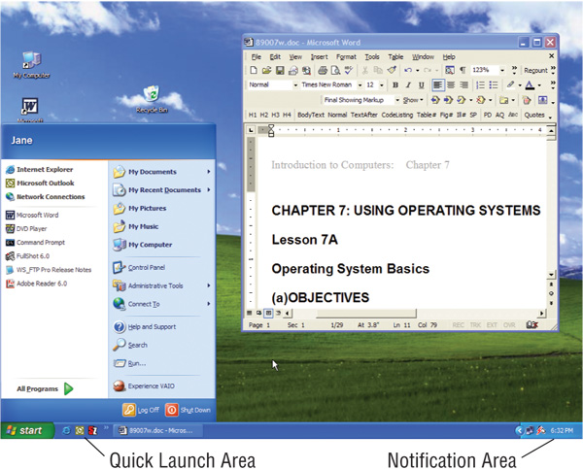
Graphical User Interface

Slide 12
Providing a User Interface
Command line interfaces
  Older interface
    DOS, Linux, UNIX
  User types commands at a prompt
  User must remember all commands
  Included in all GUIs
Notes:
Teaching tip
Demonstrate the command line interface in Windows by running cmd. In the command line interface use ping and ipconfig as commands that cannot be run in the GUI.

Slide 13
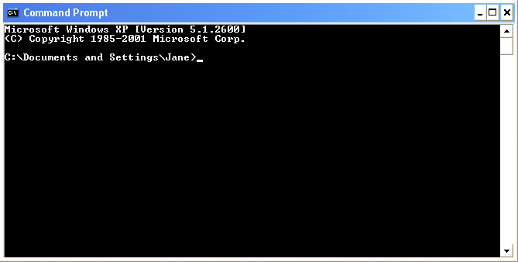
Command Line Interface

Slide 14
Running Programs
Many different applications supported
System call
  Provides consistent access to OS features
Share information between programs
  Copy and paste
  Object Linking and Embedding
Notes:
Teaching tip
Most students have never encountered a link. I use MS Excel and MS Word to link. Create and save a simple spreadsheet in Excel. Copy the spreadsheet to the clipboard. Open MS Word and paste-link the spreadsheet. Save the MS Word document. Then change and save the spreadsheet in Excel. The word document is automatically updated.

Slide 15
Managing Hardware
Programs need to access hardware
Interrupts
  CPU is stopped
  Hardware device is accessed
Device drivers control the hardware
Notes:
Discussion point
The mouse uses an interrupt. Many users will move the mouse while waiting for the CPU to finish a task. What does moving the mouse do to the current process?
Teaching tip
Discuss what can happen when the wrong driver is installed on a computer.

Slide 16
Organizing Files and Folders
Organized storage
Long file names
Folders can be created and nested
All storage devices work consistently

Slide 17
Enhancing an OS
Utilities
  Provide services not included with OS
  Goes beyond the four functions
  Firewall, anti-virus and compression
  Prices vary
Notes:
Discussion point
With Windows XP and SP2, Microsoft has included a firewall and pop-up blocker both typically considered utility software. In the near future, the core services provided by an OS may include security features.

Slide 18
Enhancing an OS
Backup software
  Archives files onto removable media
  Ensures data integrity
  Most OS include a backup package
  Many third party packages exist

Slide 19
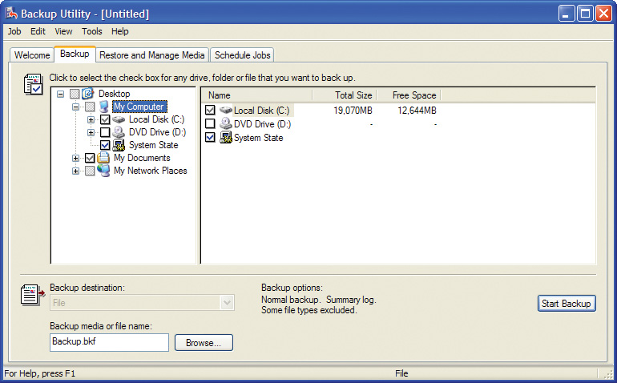
Backup Software

Slide 20
Enhancing an OS
Anti-virus software
  Crucial utility
  Finds, blocks and removes viruses
  Must be updated regularly
  McAfee and Norton Anti-Virus

Slide 21
Enhancing an OS
Firewall
  Crucial utility
  Protects your computer from intruders
  Makes computer invisible to hackers
  Zone Labs is a home firewall
  Cisco sells hardware firewalls
Notes:
Teaching tip
Windows XP includes a firewall. Service pack 2 will turn this firewall on by default. To test your computer’s security visit www.grc.com and run the various Shields Up! tests

Slide 22
Enhancing an OS
Intrusion detection
  Often part of a firewall package
  Announces attempts to breach security
  Snort is a Linux based package

Slide 23
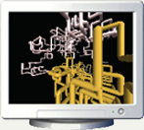
Enhancing an OS
Screen savers
  Crucial utility for command line systems
    Prevents burn in
  Merely fun for GUI systems
  Screen saver decorates idle screens

Slide 24
Chapter 7A
End of Chapter

